Slide 1
Session 02
Relational Algebra

Slide 2
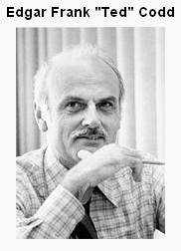
Relational model
A relation is a set of tuples
Formal manipulation language:
Relational algebra
Developed before SQL
SQL is partly based on concepts from relational algebra

Slide 3
Relational algebra
Importance
Formal foundation for relational model operations
Basis for implementing and optimizing queries in the query processing
Some concept are incorporated in SQL

Slide 4
Relational Algebra
The algebra operations produce new relations, which can be further manipulated using operations of the same algebra.
A sequence of relational algebra operations forms a relational algebra expression.
Tables in
Tables in
Rel. Op.
Table out

Slide 5
The Relational Algebra
Operates on relations, that is: input to the operations are relations (tables) and the result is a relation (table)
Operations:
Row selection (SELECT/RESTRICT)
Horizontal
Column selection (PROJECT)
Vertical
Combining tables (JOIN)
Set operations (UNION, INTERSECTION, DIFFERENCE, PRODUCT)

Slide 6
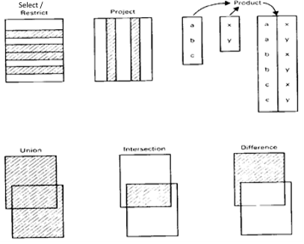
Relational Algebra - Overview

Slide 7
Notation
Row selection: Greek letter sigma:
σ_{<condition>}(<relation-expr>)
Column selection: Greek letter pi:
π_{<attribute-list>}(<relation-expr>)

Slide 8
Unary Relational Operations
SELECT Operation
SELECT operation is used to select a subset of the tuples from a relation that satisfy a selection condition. It is a filter that keeps only those tuples that satisfy a qualifying condition – those satisfying the condition are selected while others are discarded.
In general, the select operation is denoted by σ _{<selection condition>}(R) where the symbol σ (sigma) is used to denote the select operator, and the selection condition is a Boolean expression specified on the attributes of relation R

Slide 9
Unary Relational Operations
SELECT Operation
Example: To select the EMPLOYEE tuples whose department number is four:
σDNO = 4 (EMPLOYEE)
Example: To select the EMPLOYEE tuples where salary is greater than $30,000 the following notation is used:
σSALARY > 30,000 (EMPLOYEE)

Slide 10
Unary Relational Operations
PROJECT Operation
This operation selects certain columns from the table and discards the rest.
The PROJECT creates a vertical partitioning
- one with the needed columns (attributes) containing results of the operation - other containing the discarded Columns.
The general form of the project operation is π_{<attribute list>}(R)
where π (pi) is the symbol used to represent the project operation and <attribute list> is the desired list of attributes from the attributes of relation R.
The project operation removes any duplicate tuples, so the result of the project operation is a set of tuples and hence a valid relation.

Slide 11
Unary Relational Operations
PROJECT Operation
Example: To list each employee’s first and last name and salary, the following is used:
π_{LNAME, FNAME,SALARY}(EMPLOYEE)

Slide 12
Sequences of operations Rename operation
DEPT5_EMPS ← σDNO = 5 (EMPLOYEE)
RESULT ← π_{LNAME, FNAME,SALARY}(DEPT5_EMPS)

Slide 13
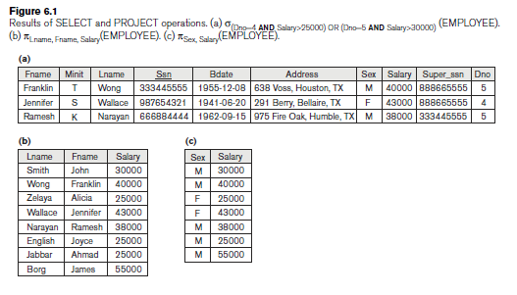
Unary Relational Operations
Notes:
Fig 6.1

Slide 14
Relational Algebra Operations From Set Theory
Set operations:
Union: R ∪ S
Intersection: S ∩ S
Set difference R \ S (or MINUS): R – S
Cartesian (or cross) product: R × S

Slide 15
Relational Algebra Operations From Set Theory
Type Compatibility
The operand relations R₁(A₁, A₂, ..., A_{n}) and R₂(B₁, B₂, ..., B_{n}) must have the same number of attributes, and the domains of corresponding attributes must be compatible; that is, dom(A_{i})=dom(B_{i}) for i=1, 2, ..., n.
The resulting relation for R₁∪R₂, R₁ ∩ R₂, or R₁-R₂ has the same attribute names as the first operand relation R₁ (by convention).

Slide 16
Relational Algebra Operations From Set Theory
UNION Operation: ∪
The result of this operation, denoted by R ∪ S, is a relation that includes all tuples that are either in R or in S or in both R and S. Duplicate tuples are eliminated.

Slide 17
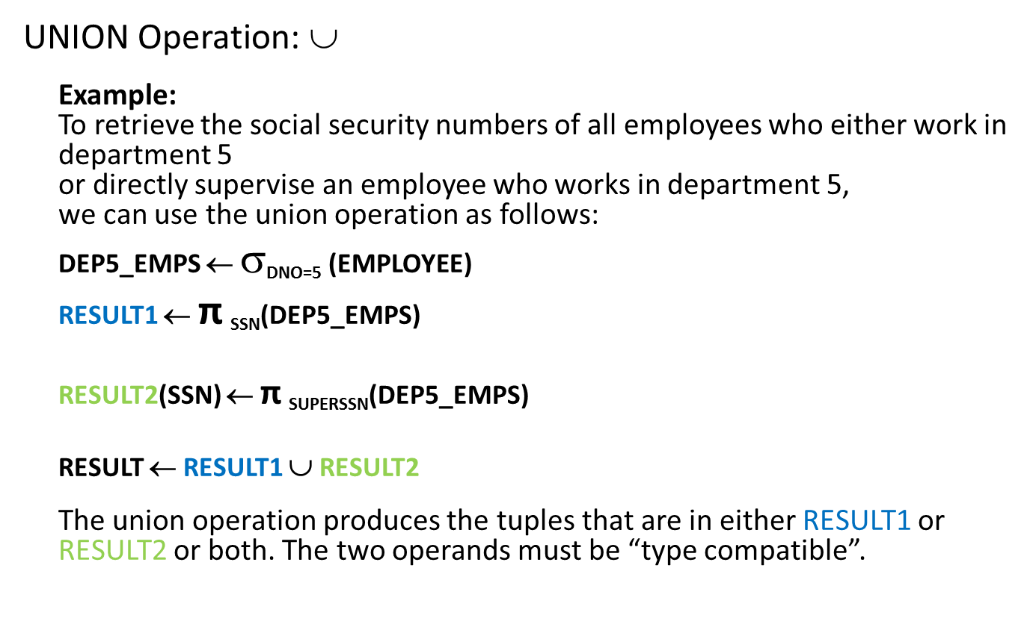
Relational Algebra Operations From Set Theory
UNION Operation: ∪
Example: To retrieve the social security numbers of all employees who either work in department 5 or directly supervise an employee who works in department 5, we can use the union operation as follows:
DEP5_EMPS ← $$_{DNO=5} (EMPLOYEE)
RESULT1 ← π _{SSN}(DEP5_EMPS)
RESULT2(SSN) ← π _{SUPERSSN}(DEP5_EMPS)
RESULT ← RESULT1 ∪ RESULT2
The union operation produces the tuples that are in either RESULT1 or RESULT2 or both. The two operands must be “type compatible”.

Slide 18
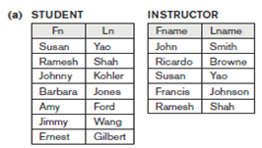

Relational Algebra Operations From Set Theory
INTERSECTION OPERATION: ∩
The result of this operation, denoted by R ∩ S, is a relation that includes all tuples that are in both R and S. The two operands must be "type compatible"
Example: The result of the intersection operation (figure below) includes only those who are both students and instructors.

Slide 19
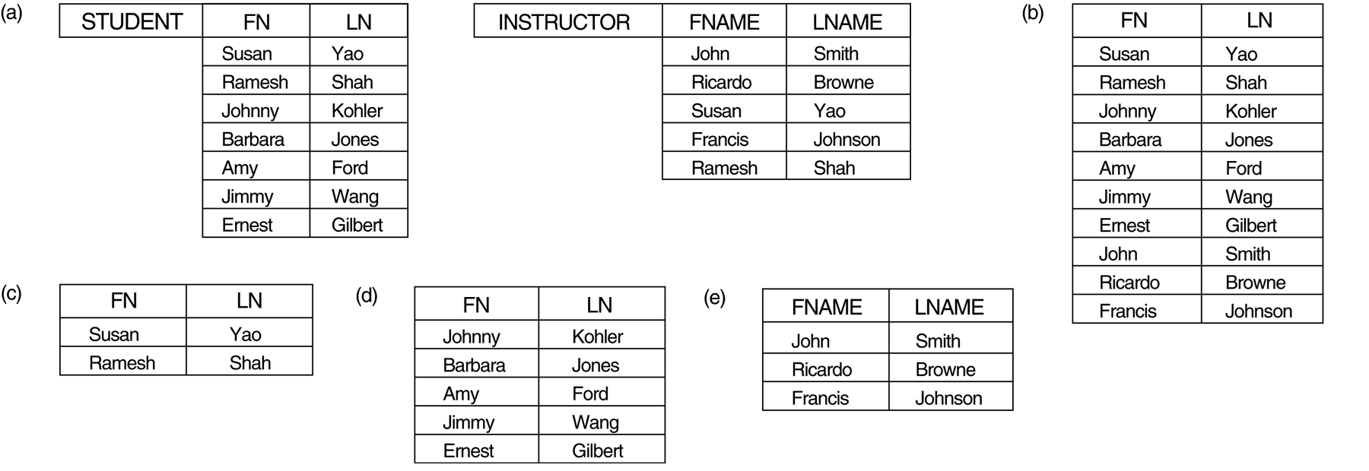
Relational Algebra Operations From Set Theory
Set Difference (or MINUS) Operation
The result of this operation, denoted by R \ S (or R – S), is a relation that includes all tuples that are in R but not in S. The two operands must be "type compatible”.
Example: The figure shows the names of students who are not instructors, and the names of instructors who are not students.
STUDENT-INSTRUCTOR
INSTRUCTOR-STUDENT

Slide 20
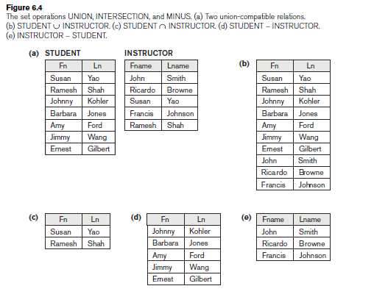
Relational Algebra Operations From Set Theory
Notes:
Figur 6.4 a and b

Slide 21
Relational Algebra Operations From Set Theory
CARTESIAN (or cross product) Operation
This operation is used to combine tuples from two relations in a combinatorial fashion. In general, the result of R(A₁, A₂, . . ., A_{n}) x S(B₁, B₂, . . ., B_{m}) is a relation Q with degree n + m attributes Q(A₁, A₂, . . ., A_{n}, B₁, B₂, . . ., B_{m}), in that order. The resulting relation Q has one tuple for each combination of tuples—one from R and one from S.
Hence, if R has n_{R} tuples (denoted as |R| = n_{R} ), and S has n_{S} tuples, then
| R x S | will have n_{R} * n_{S} tuples.
The two operands do NOT have to be "type compatible”
Example:
FEMALE_EMPS ← σ _{SEX=’F’}(EMPLOYEE)
EMPNAMES ← π _{FNAME, LNAME, SSN} (FEMALE_EMPS)
EMP_DEPENDENTS ← EMPNAMES x DEPENDENT
ACTUAL_DEPENDENTS ← σ _{SSN=ESSN}(EMP_DEPENDENTS)
RESULT ← π _{FNAME, LNAME, DEPENDENT_NAME}(ACTUAL_DEPENDENTS)

Slide 22
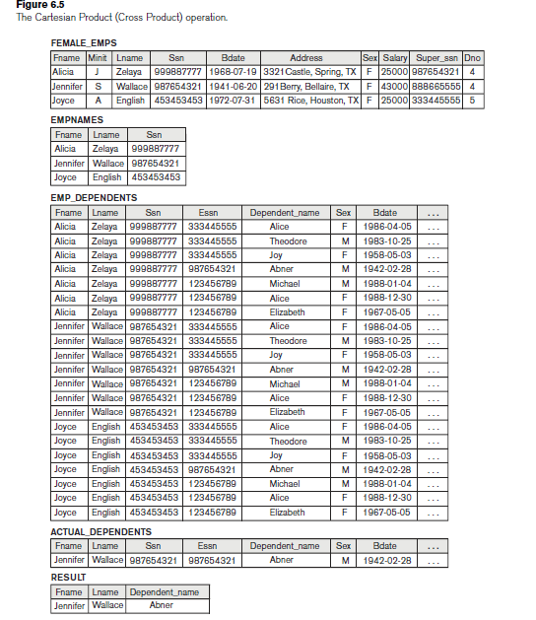
Relational Algebra Operations From Set Theory
FEMALE_EMPS ← σ _{SEX=’F’}(EMPLOYEE)
EMPNAMES ← π _{FNAME, LNAME, SSN} (FEMALE_EMPS)
EMP_DEPENDENTS ← EMPNAMES x DEPENDENT
ACTUAL_DEPENDENTS ← σ _{SSN=ESSN}(EMP_DEPENDENTS)
RESULT ← π _{FNAME, LNAME, DEPENDENT_NAME}(ACTUAL_DEPENDENTS)
Notes:
Figur 6.5

Slide 23
Binary Relational Operations
JOIN Operation
The general form of a join operation on two relations R(A₁, A₂, . . ., A_{n}) and S(B₁, B₂, . . ., B_{m}) is:
R _{<join condition>} S
where R and S can be any relations that result from general relational algebra expressions.

Slide 24
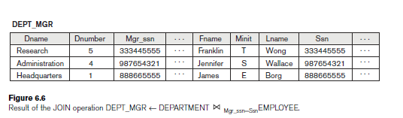
Binary Relational Operations
Example: Suppose that we want to retrieve the name of the manager of each department. To get the manager’s name, we need to combine each DEPARTMENT tuple with the EMPLOYEE tuple whose SSN value matches the MGRSSN value in the department tuple. We do this by using the join operation.
DEPT_MGR ← DEPARTMENT _{MGRSSN=SSN} EMPLOYEE

Slide 25
Binary Relational Operations
EQUIJOIN Operation
The most common use of join involves join conditions with equality comparisons only. Such a join, where the only comparison operator used is =, is called an EQUIJOIN. In the result of an EQUIJOIN we always have one or more pairs of attributes (whose names need not be identical) that have identical values in every tuple.
The JOIN seen in the previous example was EQUIJOIN.
NATURAL JOIN Operation *
Because one of each pair of attributes with identical values is superfluous, a new operation called natural join—denoted by ‘*’ — was created to get rid of the second (superfluous) attribute in an EQUIJOIN condition.
The standard definition of natural join requires that the two join attributes, or each pair of corresponding join attributes, have the same name in both relations. If this is not the case, a renaming operation must be applied first.

Slide 26
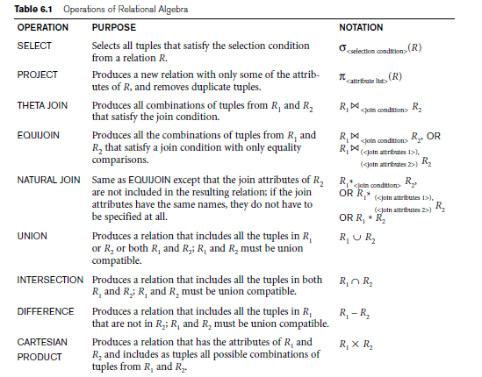
Recap of Relational Algebra Operations

Slide 27
Additional Relational Operations
Aggregate Functions and Grouping
A type of request that cannot be expressed in the basic relational algebra is to specify mathematical aggregate functions on collections of values from the database.
Examples of such functions include retrieving the average or total salary of all employees or the total number of employee tuples. These functions are used in simple statistical queries that summarize information from the database tuples.
Common functions applied to collections of numeric values include SUM, AVERAGE, MAXIMUM, and MINIMUM. The COUNT function is used for counting tuples or values.

